Slide 1
Sparse Matrix and Polynomials
Prepared by
S.Mahalakshmi AP/ISE

Slide 2
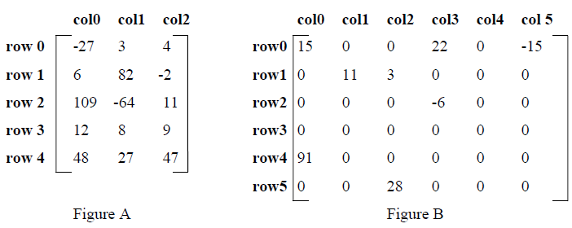
SPARSE MATRICES
A “m x n” Matrix is said to be a sparse matrix if many of its elements are zero.
(Or)
A matrix which contains many zero entries or very few non-zero entries is called as Sparse matrix.

Slide 3
A sparse matrix can be represented in
1-Dimension
2- Dimension
3- Dimensional array.
When a sparse matrix is represented as a two-dimensional array as shown in Figure B, more space is wasted
Example: consider the space requirements necessary to store a 1000 x 1000 matrix that has only 2000 non-zero elements but allocate 1,000,000 elements

Slide 4
Sparse Matrix Representation
An element within a matrix can characterize by using the triple <row,col,value> This means that, an array of triples is used to represent a sparse matrix.
Organize the triples so that the row indices are in ascending order.
To perform any operation on a sparse matrix the following needs to be known
Number of rows
Number of columns
Number of nonzero elements

Slide 5
Struct sparse
{
int row;
int col;
int value
};
Struct sparse a[50];
a[0]. row → the number of rows .
a[0]. col → the number of columns .
a[0]. value →the total number of nonzero elements .
The triples are ordered by rows and within rows by columns
Sparse matrix stored as triple
a[0] | 6 | 6 | 8
[1] | 0 | 0 | 15
[2] | 0 | 3 | 22
[3] | 0 | 5 | -15
[4] | 1 | 1 | 11
[5] | 1 | 2 | 3
[6] | 2 | 3 | -6
[7] | 4 | 0 | 91
[8] | 5 | 2 | 28

Slide 6
Transposing a Sparse Matrix
Transpose of a matrix can be done by interchanging the rows and columns.
This means each element a[i] [j] in the original matrix will become b[j] [i] in the transposed matrix.
Direct interchanging of rows and columns is not correct in case of sparse matrices because the ordering of rows and columns in the representation will be lost

Slide 7
a[0] | 6 | 6 | 8
[1] | 0 | 0 | 15
[2] | 0 | 3 | 22
[3] | 0 | 5 | -15
[4] | 1 | 1 | 11
[5] | 1 | 2 | 3
[6] | 2 | 3 | -6
[7] | 4 | 0 | 91
[8] | 5 | 2 | 28
b[0] | 6 | 6 | 8
[1] | 0 | 0 | 15
[2] | 0 | 4 | 91
[3] | 1 | 1 | 11
[4] | 2 | 1 | 3
[5] | 2 | 5 | 28
[6] | 3 | 0 | 22
[7] | 3 | 2 | -6
[8] | 5 | 0 | -15
Fig (a): Sparse matrix stored as triple Fig (b): Transpose matrix stored as triple

Slide 8
A good algorithm for transposing a matrix:
for each row i
take element <i, j, value> and store it as
element <j, i, value> of the transpose;
Disadvantage
If we process the original matrix by the row indices it is difficult to know exactly where to place element <j, i, value> in the transpose matrix until we processed all the elements that precede it.
Solution
This can be avoided by using the column indices to determine the placement of elements in the transpose matrix. This suggests the following algorithm:
for all elements in column j
place element <i, j, value> in
element <j, i, value>

Slide 9
void transpose (term a[], term b[])
{ /* b is set to the transpose of a */
int n, i, j, currentb;
b[0].row = a[0].col; /* rows in b = columns in a */
b[0].col = a[0].row; /* columns in b = rows in a */
b[0].value = a[0].value;
n = a[0].value; /* total number of elements */
if (n > 0) /* nonzero matrix */
{ k = 1; II position to put the next transposed triple in b
for (i = 0; i < a[0].col; i++)
for (j= 1; j<=n; j++)
if (a[j].col == i)
{
b[k].row = a[j].col;
b[k].col = a[j].row;
b[k].value = a[j].value;
k++;
}
}
}

Slide 10
POLYNOMIALS
A polynomial is a sum of terms, where each term has a form ax^{e} , where x is the variable, a is the coefficient and e is the exponent.”
Two example polynomials are:
A(x) =3x²⁰ + 2x⁵ + 4
B(x) =x⁴ + 10x³ + 3x² +1
The largest (or leading) exponent of a polynomial is called its degree.
Coefficients that are zero are not displayed.
The term with exponent equal to zero does not show the variable since x raised to a power of zero is 1.

Slide 11
Polynomial Representation-1
Assumption Exponents/ powers are arranged in decreasing order.
#define MAX-DEGREE 101 /*Max degree of polynomial+1*/
typedef struct
{
int degree;
float coef[MAX-DEGREE];
} polynomial;
Now if a is a variable and is of type polynomial and
n < MAX_DEGREE,
The polynomial A(x) = Σai xi would be represented as:
a.degree = n
a.coef[i] = a_{n-i} , 0 ≤ i ≤ n

Slide 12
In this representation, the coefficients is stored in order of decreasing exponents, such that a.coef [i] is the coefficient of x^{n-i} provided a term with exponent n-i exists;
Otherwise, a.coef [i] =0. This representation leads to very simple algorithms for most of the operations, it wastes a lot of space.

Slide 13
Polynomial Representation-2
To preserve space an alternate representation that uses only one global array, terms to store all polynomials.
MAX_TERMS 100 /*size of terms array*/ typedef struct
{
float coef;
int expon;
} polynomial;
polynomial terms[MAX-TERMS];
int avail = 0;

Slide 14
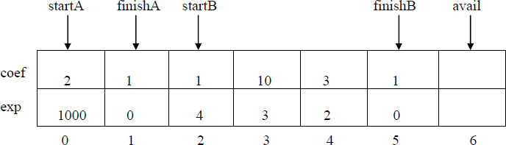
Consider the two polynomials
A(x) = 2x^{l000}+ 1
B(x) = x⁴ + 10x³ + 3x² + 1
For above example, startA=0, finishA=1, startB=2, finishB=5, & avail=6.

Slide 15
Polynomial Addition
void padd(int startA, int finishA, int startB, int finishB, int
*startD,int *finishD)
{ /* add A(x) and B(x) to obtain D(x) */
float coefficient;
*startD = avail;
while (startA <= finishA && startB <= finishB) switch(COMPARE(terms[startA].expon, terms[startB].expon))
{
case -1: /* a expon < b expon */
attach (terms [startB].coef, terms[startB].expon);
startB++;
break;

Slide 16
case 0: /* equal exponents */
coefficient = terms[startA].coef + terms[startB].coef;
if (coefficient)
attach (coefficient, terms[startA].expon);
startA++;
startB++;
break;
case 1: /* a expon > b expon */
attach (terms [startA].coef, terms[startA].expon);
startA++;
}

Slide 17
/* add in remaining terms of A(x) */
for(; startA <= finishA; startA++)
attach (terms[startA].coef, terms[startA].expon);
/* add in remaining terms of B(x) */
for( ; startB <= finishB; startB++)
attach (terms[startB].coef, terms[startB].expon);
*finishD = avail-i;

Slide 18
Function to add new term
void attach (float coefficient, int exponent)
{ /* add a new term to the polynomial */
if (avail >= MAX-TERMS)
{
fprintf(stderr,"Too many terms in the polynomial\n");
exit(EXIT_FAILURE);
}
terms[avail].coef = coefficient;
terms[avail++].expon = exponent;
}

